Slide 1
Digital Portfolio
STUDENT NAME: M.MOHAMMAD MANSOOR
REGISTER NO AND NMID: 36624U1817
:-3E7F4BA5612E414BAEA42ECBA1CE6865
DEPARTMENT: BSc.Computer Science
COLLEGE: MERIT HAJI ISMAIL SAHIB ARTS & SCIENCE COLLEGE/ THIRUVALLUVAR UNIVERSITY.
1
Notes:
1

Slide 2
PROJECT TITLE
STUDENT PORTFOLIO &
PERSONAL WEBSITE FOR A
DIGITAL RESUME
2

Slide 3


AGENDA
Problem Statement
Project Overview
End Users
Tools and Technologies
Portfolio design and Layout
Features and Functionality
Results and Screenshots
Conclusion
Github Link
3/21/2024 Annual Review
3

Slide 4

PROBLEM STATEMENT
" In today's competitive digital word ,students and graduates need a professional way to showcase their academic details ,skills ,project work .Traditional resumes are limited
And often fail to provide interactive ,engaging ,and accessible information about an individual. There is a lack of personalized platform where students can highlight their achievements ,technical skills ,and projects in an attractive and responsive manner."
4

Slide 5

PROJECT OVERVIEW
" 📖 Brief Summary of My Project – Portfolio Website
The Personal Portfolio Website is a responsive and attractive web application developed to showcase my academic details, technical skills, project works, and contact information in one place. It is designed as a digital resume that highlights my professional identity and makes it easier for recruiters, faculty, and peers to know more about me.
The website consists of multiple sections such as a Hero section with my photo and name, an About Me section with my education and personal details, a Skills section listing my technical knowledge in Python, C++, HTML, CSS, and Data Structures & Algorithms, a Projects section linked to my GitHub repositories
5

Slide 6

WHO ARE THE END USERS?
1 .Recruiters and Hiring Managers
2 .College Faculty/Evaluators
3 .Peers and Collabrators
4 .Genral Audience
5 .Visitors
6

Slide 7

TOOLS AND TECHNIQUES
TOOLS
1 . Visual Studio ------>Write and debug HTML ,CSS & JS.
2 .Web browser------>To test and preview of mobile and pc.
3 . Git Hub------>To share project repositories.
4 .Git hub pages----->For deploying the porfolio websites.
5 . Canva ----->image adding and editing
7

Slide 8
POTFOLIO DESIGN AND LAYOUT
1. Navigation Bar
Placed at the top of the website.
Contains links to all major sections: Home, About, Skills, Projects, and Contact.
Stays consistent across all pages for easy navigation.
2. Hero Section
Displays my name (Mohammad Mansoor M) and a professional photo with a glowing circular effect.
Includes background animations and colorful typography to make a strong first impression.
3. About Me Section
Contains my personal introduction, college details, Nan Mudhalvan ID, GitHub link
Presents a email address .
Professional and readable format
4. Skill Section
List of my techniques and Python ,c++,HTML,Data structures and algorithms
Using styling icons and progress bar
8

Slide 9
DESIGN AND LAYOUT
5. Projects Section
Highlights my project work with clickable GitHub links that redirect to my profile.
Organized in a card/grid format for visual appeal.
6. Contact Section
Provides my email ID ( mansoormohd2006@gmail.com ) with a simple contact form (Name, Email, Message, Submit button).
Allows visitors to directly connect with me.
7. Footer Section
Contains copyright info and quick links.
Designed with a contrasting background
GITHUB LINK :https://mansoormohd2006-afk.github.io/TNSDC-FWD-DigitalPortfolio/

Slide 10
DESIGN
Colorful Fonts & Backgrounds: Used to make the site attractive and lively.
Animations & Hover Effects: Add interactivity and modern look.
Responsive Layout: Built with CSS media queries so the site adapts to both mobile and desktop screens.
Consistent Theme: A balance of creativity and professionalism throughout the website.

Slide 11
FEATURES AND FUNCTIONALITY
User friendly navigation bar---->links to all sections
Attractive hero section ---->Displays my name and my circular profile
About me Section----->Contains college details and Nan Mudhalvan id ,Github link and gmail
Skill Section ----->Show case my skills like Python,C++,HTML AND Data structure
Project Section---->include my github project links and my project proramming works
Contact Section----->features my gmail and Message field to help user easily connect with me
Responsive Design----->Works seamlessly on mobile and desktop ,laptop,tablet and mobile devices all types of user can access easily
Modern and Attractive----->its colorful typography,animated backgrounds,and hover effects

Slide 12
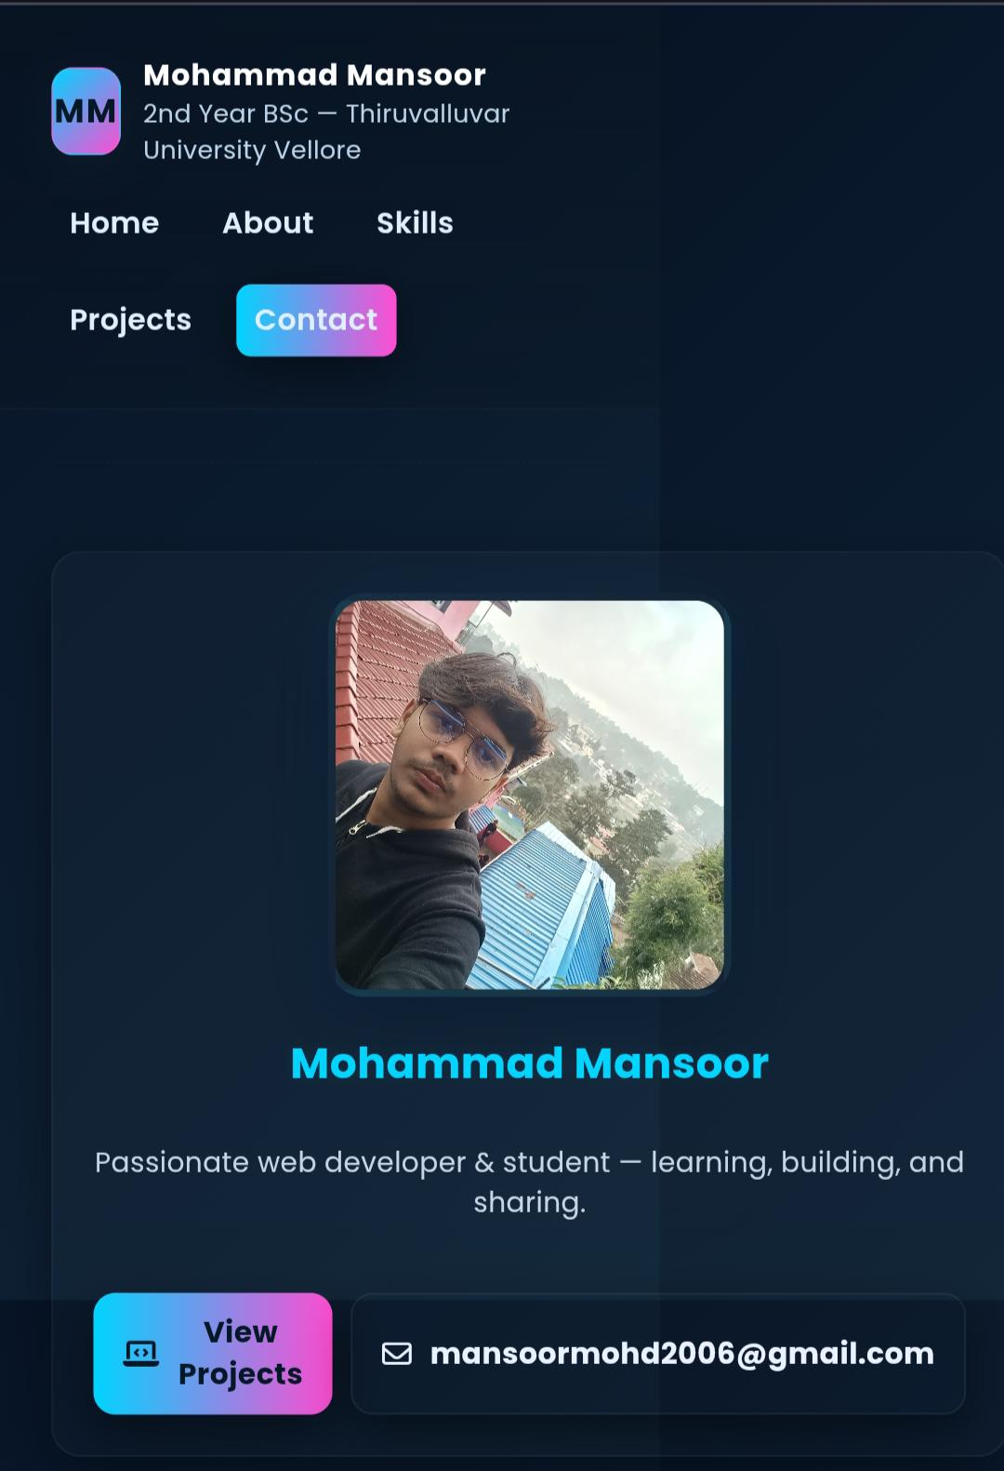

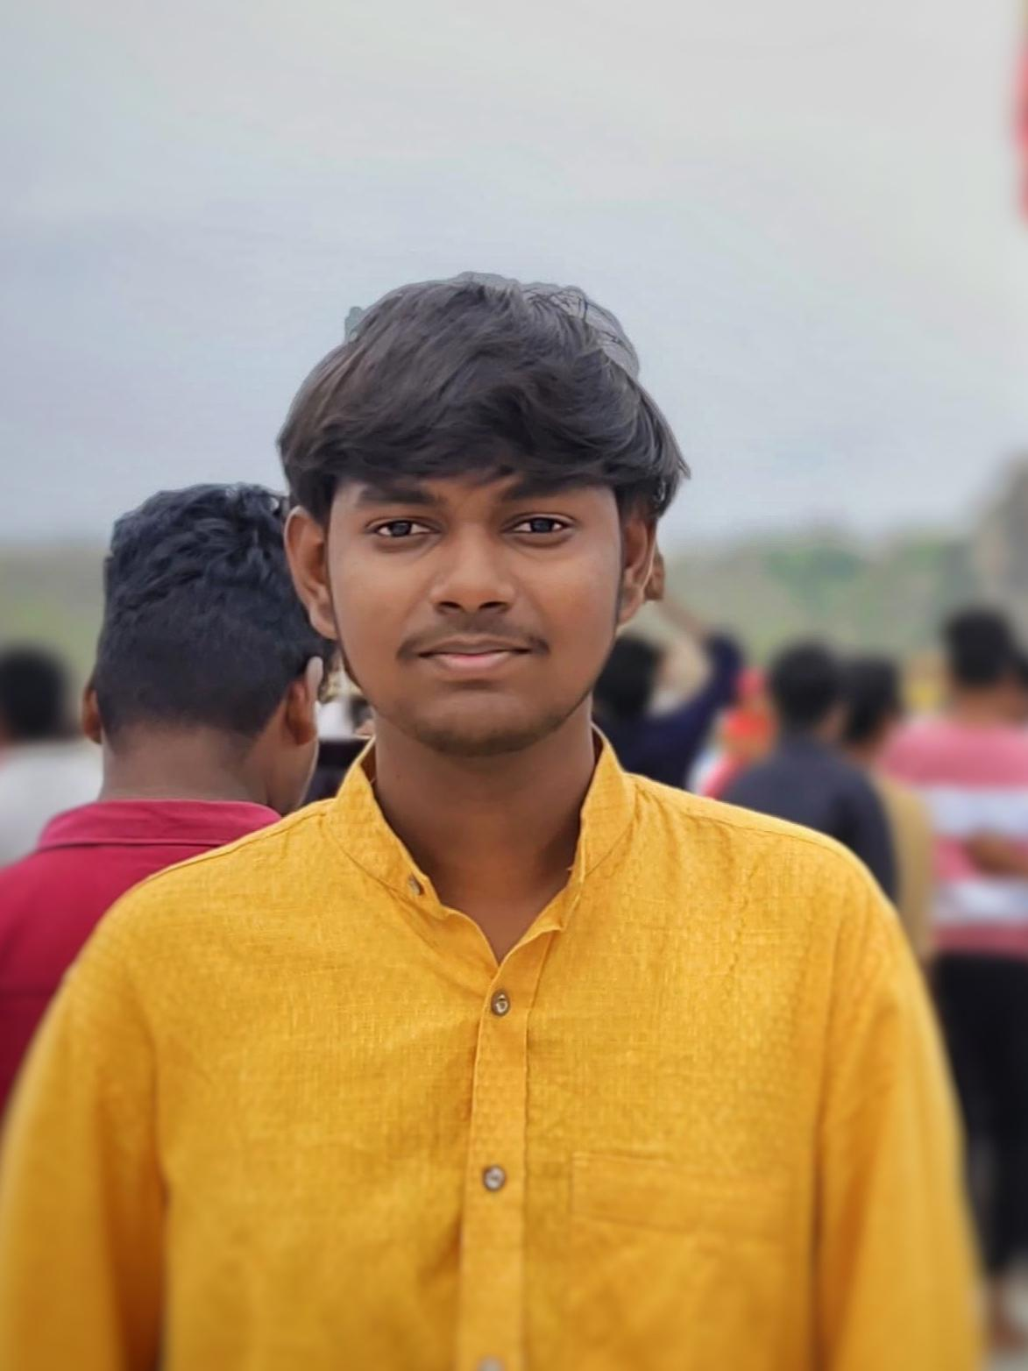
RESULTS AND SCREENSHOTS
3/21/2024 Annual Review
12

Slide 13
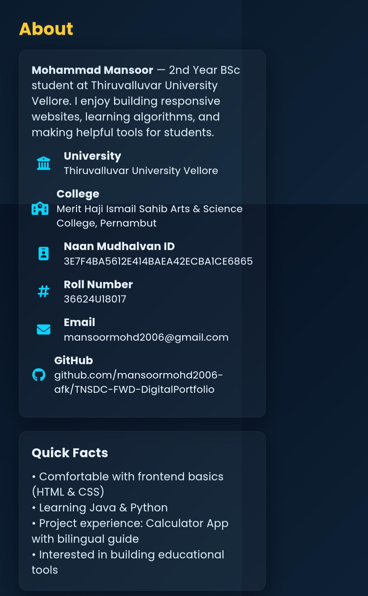
ABOUT PAGE

Slide 14
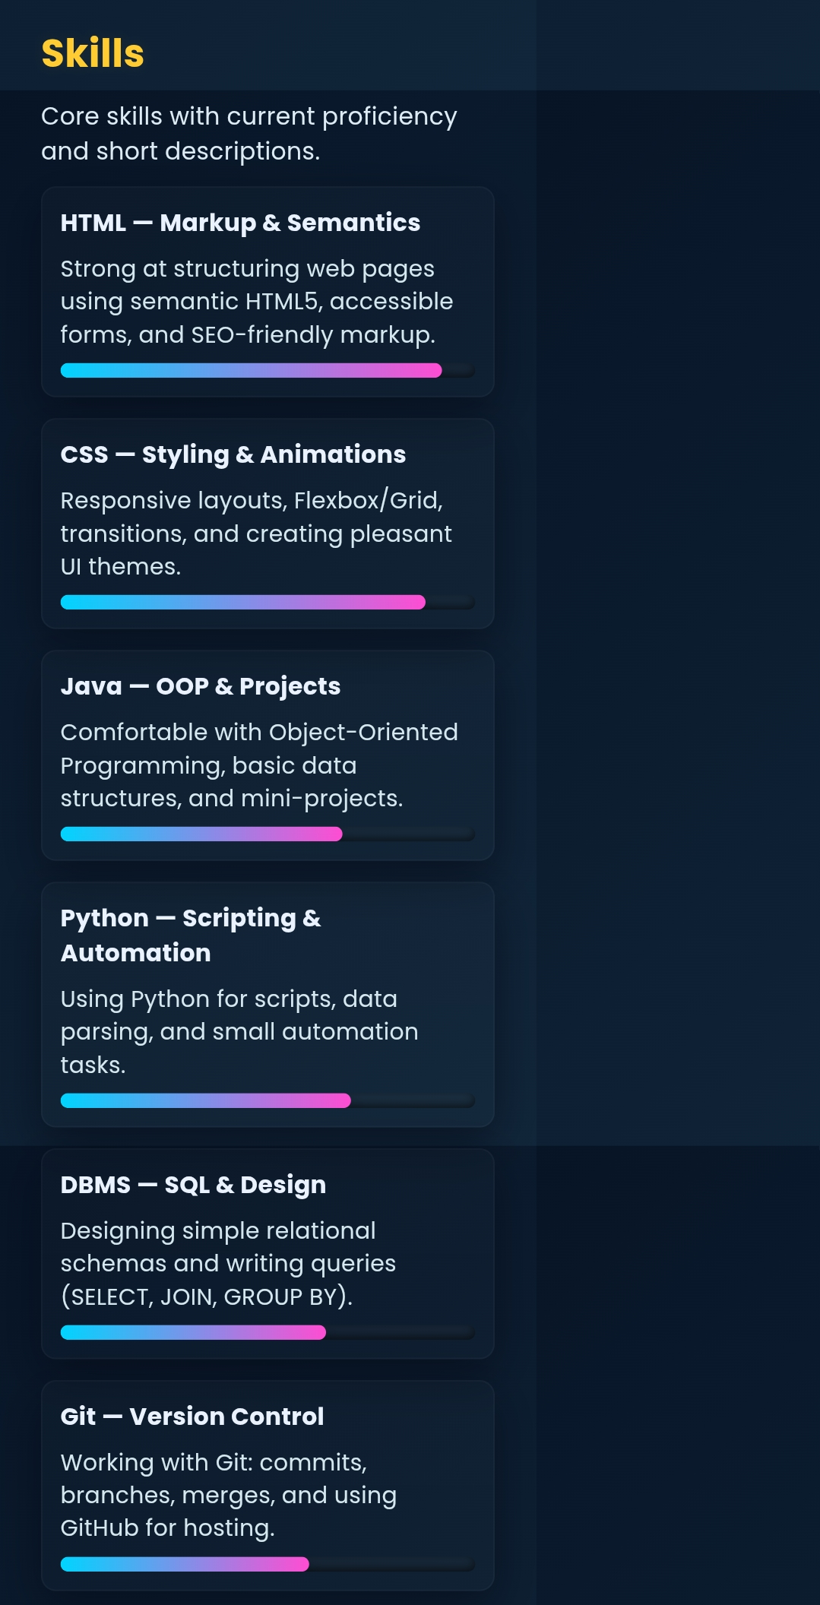

Slide 15
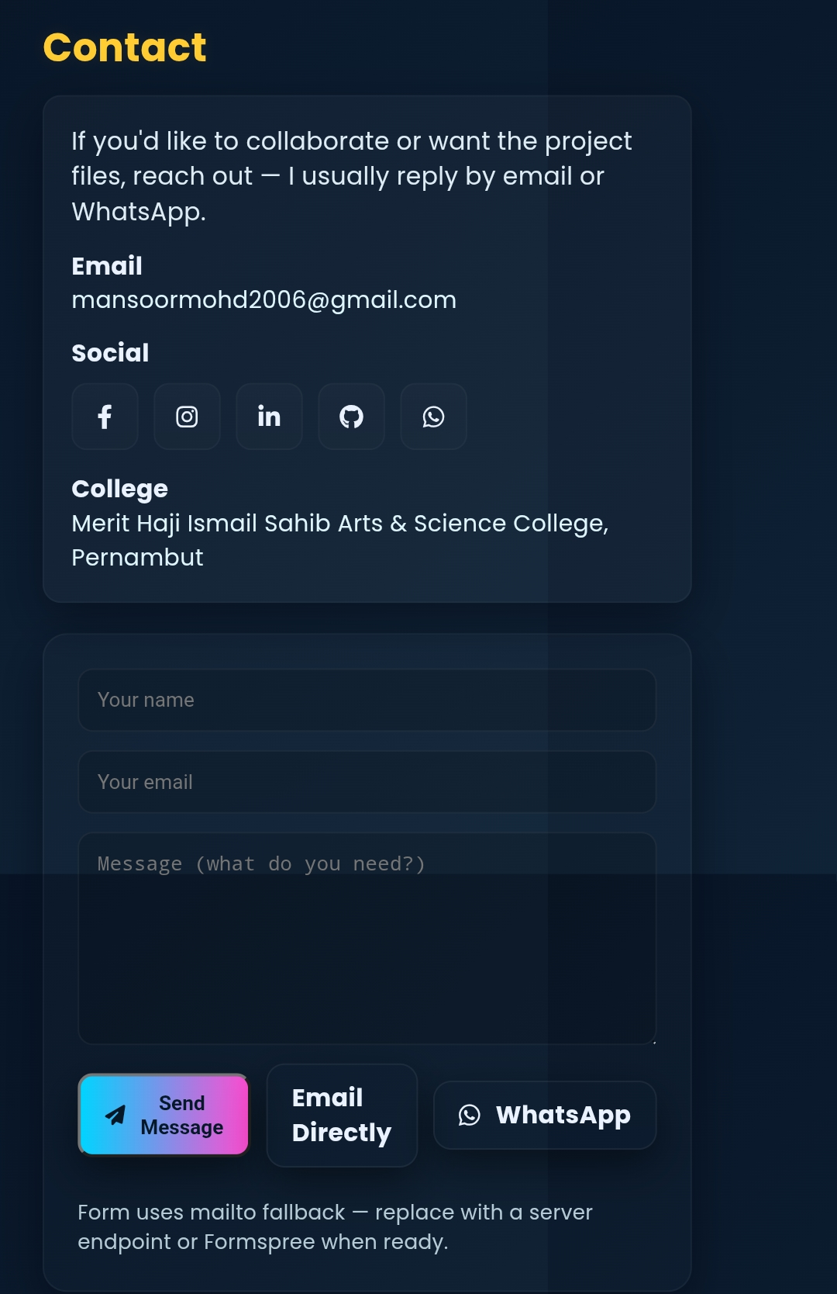
CONTACT ME PAGE

Slide 16
CONCLUSION
Highlights a professional digital identity to show case my education skills and projects in single platform
2. responisive and modern animations and user friendly and direrct connection between me and potential oppurtunities.
3. Encourage students to build their own digital portfolios.
4. Helps recruiters and educators easily access their student profile at theirb own created website
5. Reduse dependency on paper redumes ,promotes a digital-first approach to carrer development.
16

